Slide 1
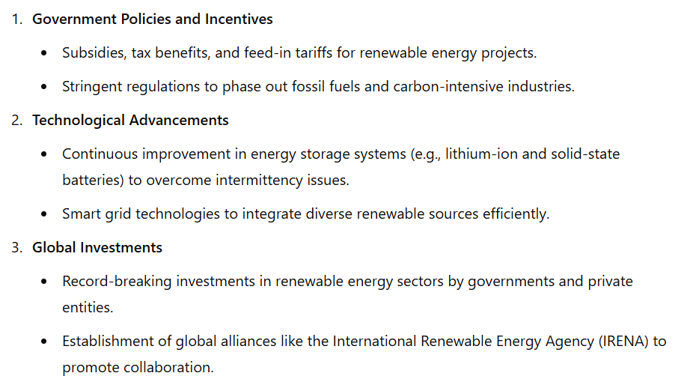
Development of renewable energy sources

Slide 2
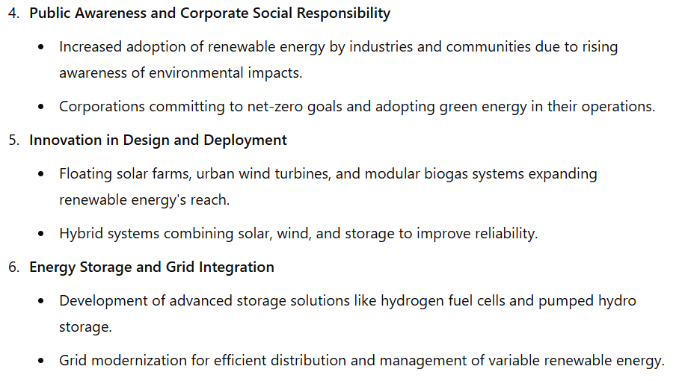
Development of renewable energy sources

Slide 3
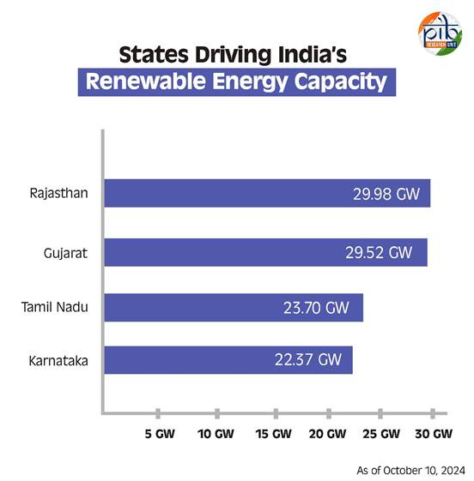
Leading States in Renewable Energy Capacity
Several states in India have emerged as leaders in renewable energy capacity, contributing significantly to the nation's progress.
Rajasthan tops the list with an impressive 29.98 GW of installed renewable energy capacity, benefiting from its vast land and abundant sunlight.
Following closely is Gujarat, which boasts a capacity of 29.52 GW, driven by its strong focus on solar and wind energy projects.
Tamil Nadu ranks third with 23.70 GW, leveraging its favourable wind patterns to generate substantial energy.
Karnataka rounds out the top four with a capacity of 22.37 GW, supported by a mix of solar and wind initiatives.
Together, these states play a crucial role in advancing India’s renewable energy goals and establishing a more sustainable energy future.

Slide 4
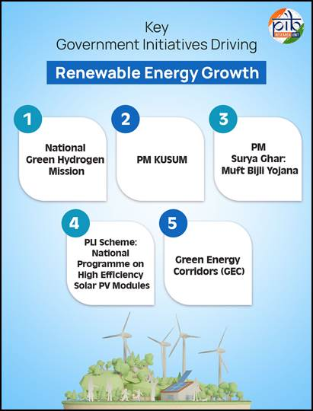
Renewable energy in India
The Government of India has implemented a range of measures and initiatives aimed at promoting and accelerating renewable energy capacity across the nation, with an ambitious target of achieving 500 GW of installed electric capacity from non-fossil sources by 2030.
Key programs include the National Green Hydrogen Mission, PM-KUSUM, PM Surya Ghar, and PLI schemes for solar PV modules.

Slide 5
Renewable energy in India
These efforts reflect the government's commitment to fostering a sustainable energy future while addressing the challenges posed by climate change and energy security. Here are some other ongoing key initiatives:
Notification of a trajectory for renewable energy power bids of 50 GW per annum by Renewable Energy Implementation Agencies (REIAs) from FY 2023-24 to FY 2027-28.
Foreign Direct Investment permitted up to 100 percent under the automatic route to attract investments.
Waiver of Inter-State Transmission System charges for solar and wind power projects commissioned by June 30, 2025; green hydrogen projects until December 2030; and offshore wind projects until December 2032.
Announced Renewable Purchase Obligation trajectory until 2029-30, including separate RPO for Decentralized Renewable Energy.
A Project Development Cell has been established to attract and facilitate investments in the renewable sector.

Slide 6
Renewable energy in India
Standard Bidding Guidelines issued for tariff-based competitive bidding for procurement of power from grid-connected solar, wind, and wind-solar projects.
Ultra Mega Renewable Energy Parks are being set up to provide land and transmission for large-scale renewable energy projects.
Cabinet approval for a Viability Gap Funding scheme for offshore wind energy projects, facilitating the installation and commissioning of 1 GW of offshore wind energy capacity along the coasts of Gujarat and Tamil Nadu.
Issued Electricity (Rights of Consumers) Rules, 2020, for net-metering up to 500 kilowatts or the electrical sanctioned load, whichever is lower.
The “National Repowering and Life Extension Policy for Wind Power Projects, 2023” has been released.
“Strategy for Establishment of Offshore Wind Energy Projects” outlines a bidding trajectory of 37 GW by 2030.

Slide 7
Renewable energy in India
Offshore Wind Energy Lease Rules, 2023, notified to regulate the grant of leases for offshore wind energy development.
Procedure for Uniform Renewable Energy Tariff (URET) has been established.
Standard & Labelling (S&L) programs for Solar Photovoltaic modules and grid-connected solar inverters have been launched.
A transmission plan has been prepared to augment transmission infrastructure until 2030.
The Electricity (Late Payment Surcharge and Related Matters) Rules have been notified.
Green Energy Open Access Rules 2022 have been issued to promote renewable energy.
Launched the Green Term Ahead Market (GTAM) to facilitate the sale of renewable energy power through exchanges.
Orders issued to ensure that power is dispatched against Letters of Credit or advance payment for timely payments to renewable energy generators.

Slide 8
Renewable energy in India
With ambitious targets set for the future, including a goal of 500 GW from non-fossil sources by 2030, India is well-positioned to emerge as a global leader in renewable energy, contributing to environmental sustainability and energy security.
These ongoing efforts reflect a holistic approach to building a greener economy, ensuring that India not only meets its energy needs but also addresses the pressing challenges of climate change and resource conservation.

